Slide 1



HANGMAN

Slide 2

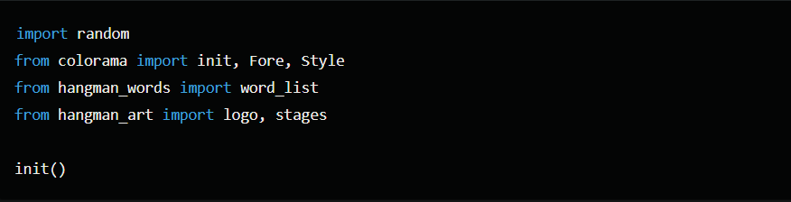
Imports and Initialization
import random: Imports the random module to allow random selection of a word.
from colorama import init, Fore, Style: Imports necessary components from the colorama library to handle colored text output in the terminal.
from hangman_words import word_list: Imports a list of potential words for the game from a module named hangman_words.
from hangman_art import logo, stages: Imports the logo and stages of the hangman art from a module named hangman_art.
init(): Initializes the colorama module to enable colored text on all platforms.

Slide 3
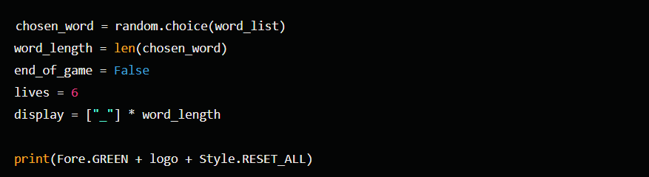

GAME SETUP
GAME SETUP
chosen_word = random.choice(word_list): Randomly selects a word from the word_list.
word_length = len(chosen_word): Determines the length of the chosen word.
end_of_game = False: A flag to indicate if the game has ended.
lives = 6: Sets the initial number of lives the player has.
display = ["_"] * word_length: Initializes a list to represent the current state of the word being guessed, with each letter replaced by an underscore.
print(Fore.GREEN + logo + Style.RESET_ALL): Prints the game logo in green.

Slide 4

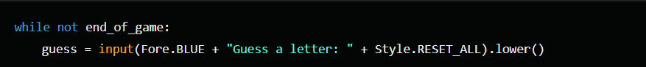
MAIN GAME LOOP
while not end_of_game:: Runs the loop as long as the game has not ended.
guess = input(Fore.BLUE + "Guess a letter: " + Style.RESET_ALL).lower(): Prompts the player to guess a letter, converts it to lowercase, and colors the prompt text in blue.

Slide 5
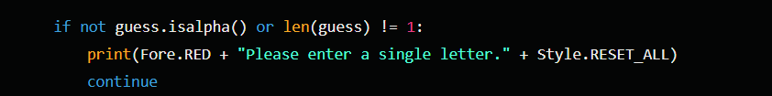

INPUT VALIDATION
if not guess.isalpha() or len(guess) != 1:: Checks if the input is a single alphabetic character.
print(Fore.RED + "Please enter a single letter." + Style.RESET_ALL): Prints an error message in red if the input is invalid.
continue: Skips to the next iteration of the loop if the input is invalid.

Slide 6

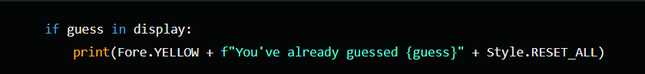
Check for Previously Guessed Letter
if guess in display:: Checks if the letter has already been guessed.
print(Fore.YELLOW + f"You've already guessed {guess}" + Style.RESET_ALL): Prints a warning message in yellow if the letter has already been guessed.

Slide 7

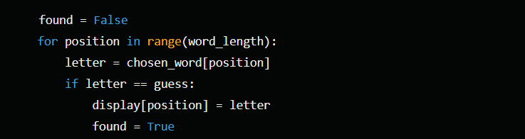
Update Display and Lives
found = False: Initializes a flag to track if the guessed letter is found in the word.
for position in range(word_length):: Iterates through each letter in the chosen word.
letter = chosen_word[position]: Gets the letter at the current position.
if letter == guess:: Checks if the guessed letter matches the current letter in the word.
display[position] = letter: Updates the display list with the correctly guessed letter.
found = True: Sets the found flag to True if the guessed letter is found in the word.

Slide 8

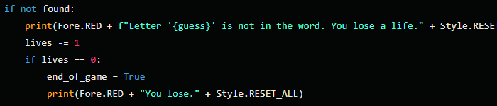
HANDLE INCORRECT GUESS
if not found:: Checks if the guessed letter is not in the word.
print(Fore.RED + f"Letter '{guess}' is not in the word. You lose a life." + Style.RESET_ALL): Prints an error message in red if the guessed letter is not in the word.
lives -= 1: Decreases the number of lives by 1.
if lives == 0:: Checks if the player has no lives left.
end_of_game = True: Sets the end_of_game flag to True if the player has no lives left.
print(Fore.RED + "You lose." + Style.RESET_ALL): Prints a game-over message in red if the player has no lives left.

Slide 9
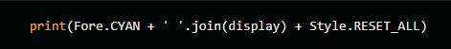
Print current word state
print(Fore.CYAN + ' '.join(display) + Style.RESET_ALL): Prints the current state of the guessed word in cyan.

Slide 10
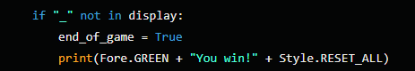
Check for Win Condition
if "_" not in display:: Checks if the player has guessed all the letters in the word.
end_of_game = True: Sets the end_of_game flag to True if the player has guessed all the letters.
print(Fore.GREEN + "You win!" + Style.RESET_ALL): Prints a victory message in green if the player has guessed all the letters.

Slide 11
Print Hangman Stage
print(stages[lives]): Prints the current stage of the hangman based on the remaining lives.

Slide 12
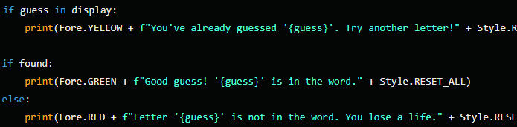
Post-Game Messages
These lines are redundant because the same checks and messages are already handled inside the main game loop. They would display a message about whether the guessed letter was already guessed, found in the word, or not found in the word, but since these checks are performed within the loop, they are not needed here.

Slide 13
Summary
The script is a simple command-line Hangman game where the player guesses letters to reveal a hidden word. The game continues until the player either guesses the word correctly or runs out of lives. The game provides visual feedback using colored text and hangman stages.

